Slide 1



Coulsdon Church of England Primary School
Year 4

Slide 2
Adults in the class:
Teachers:
Mrs Lauren Pullin – Monday-Thursday
Mrs Rebecca Lambe – Friday
TAs:
Mrs Bentley (general TA)
Mrs Ward (1:1)
Mrs Webber (1:1)
Mrs Spain (1:1)
Miss Sheehan (1:1)
Please feel free to come in and speak with any of us.
Please contact the office where a message can be passed on to us or a meeting arranged.

Slide 3
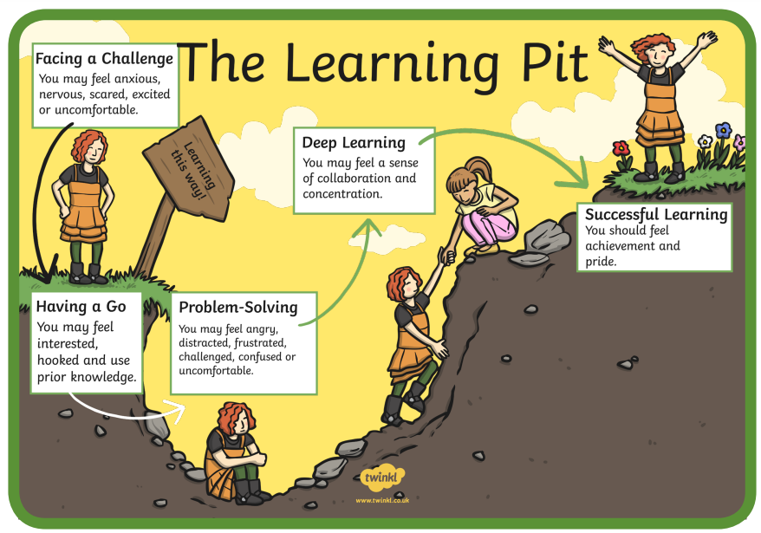
Class Expectations
We will be working on our Growth Mindset (changing our attitude to learning and growing our brain) where it is a good place to be challenged or not know an answer (being in the pit). It’s what we do about it that is important.
Our behaviours and attitudes will be focused around the Fruit of the Spirit, spending time reflecting on the nine areas - love, joy, peace, patience, kindness, goodness, faithfulness, gentleness and self-control.

Slide 4

Homework provision has been reviewed to make sure that it is consistent across the school, and age appropriate.
For Year 4 this will include:
Optional:
Activities based on, or linked to, the class theme or topic. This could be an art or investigative activity, a reading task, a written piece or a pre-learning task such as researching a topic to gain prior knowledge to use in class.
Homework is usually designed to reinforce knowledge taught in the classroom and should not be a struggle! If there is a difficulty with a piece of homework, please come in to speak with us or send a note.
Planners – Mrs Bentley will be collecting these on a Monday to check that reading has been recorded and signed.
Daily | Weekly
Reading (20 minutes) every night. | Spelling Shed (around 30 minutes a week). Maths tasks – MyMaths. Times Table Rockstars.

Slide 5
Curriculum
At Coulsdon we teach through topics. It enhances the children’s learning and increases motivation. Where possible, links are made between our curriculum subjects and the topics.
This year the pupils will look at:
Autumn
History: Invasion – Anglo-Saxons and Scots
Geography: Physical features, the National Rail network and Canals
RE: What makes an Old Testament Hero? Non-Religious World Views
Science: Sound and Animals, including humans
Art: Contrast and Complement

Slide 6
Curriculum
.
Spring
History: Invasion – Anglo-Saxons and Vikings
Geography: Mountains, Rivers and Ordnance Survey Maps
RE: What do Sikhs believe? What would Jesus do?
Science: Living Things & their Habitat
Art: Animal (clay work)

Slide 7
Curriculum
Summer
History: Ancient Egypt
Geography: Grid refences, the Tropics and North and South America
RE: How does faith guide people to try and make the world a fairer place? What do Sikhs value?
Science: Electrical circuits & conductors and States of Matter
Art: Islamic Art
Curriculum letters will be sent out termly.

Slide 8
English – Writing Genres
Autumn 1 | Autumn 2 | Spring 1 | Spring 2 | Summer 1 | Summer 2
Fiction Adventure Story - The Princess who hid in a tree - Openings and Endings Non-fiction Non-chronological Report - Anglo-Saxons | Fiction Defeating the Monster Story - Beowulf - Characterisation and Description Poetry - Rhyming Non-fiction Review Writing - The Snowman | Fiction Diary Entries - The Remarkable Story of Hillary and Norgay - Suspense Non-fiction Review writing (if unfinished) | Fiction Journey Poem - The Rhythm of the Rain -Vocabulary Non-fiction Information Text - River Leaflets | Fiction Stories from another culture - Egyptian Cinderella - Dialogue Non-fiction Instructions - Mummification | Fiction Quest Story - The Scarab’s Secret - Settings Non-fiction Historical Report - Cleopatra

Slide 9
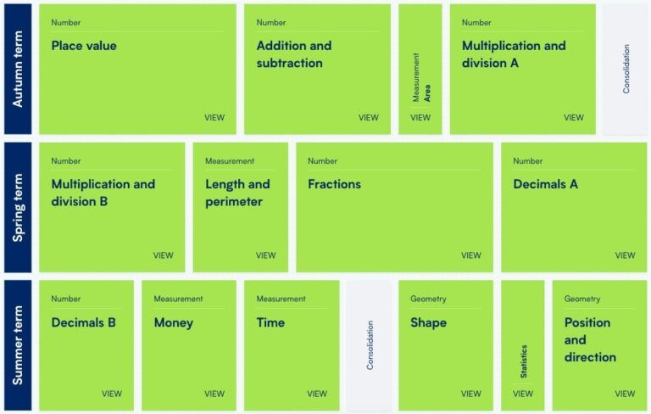
Maths Units

Slide 10


Slide 11
Educational visits and visitors
We believe that educational visits are an integral part of the curriculum and learning experience for every child. The benefits to pupils of taking part in visits and learning outside the classroom include, but are not limited to:
Increased critical curiosity and resilience.
Increased levels of trust and opportunities and to examine the concept of trust (us in them, them in us, them in themselves, them in each other) giving opportunities for genuine teamwork.
Enhanced opportunities for ‘real world’, ‘learning in context’ and the development of the social and emotional aspects of intelligence.
Improved environmental appreciation, knowledge, awareness and understanding of a variety of environments.
Physical skill acquisition and the development of a fit and healthy lifestyle. Our priority at Coulsdon is to ensure that all visits are Safe, Educational and Enjoyable!
Whilst we endeavour to keep costs to a minimum, many of these visits incur costs. We aim to give you ample time to pay for these trips – if costs are not met, trips may have to be cancelled. If you have worries or concerns regarding any trip payment, please speak to the office in complete confidence.

Slide 12


Reminders
Children are able to bring in fruit/vegetable sticks for a snack at breaktime.
Water is available in school throughout the day. Could all pupils please have a drink bottle with them (named).
PE days for Autumn term – Tuesday and Thursday.
Correct school uniform (named) and a coat every day.
8:55 start – early morning tasks.
Reading books.
Swimming – Summer term.
Please let us know if there will be any changes to who is collecting your child.

Slide 13

Any Questions?

